Slide 1

Automated Machine Learning

Slide 2
Eng Teong Cheah
Microsoft MVP

Slide 3
Automated Machine Learning
Azure Machine Learning includes an automated machine learning capability that automatically tries multiple pre-processing techniques and model-training algorithms in parallel. These automated capabilities use the power of cloud compute to find the best performing supervised machine learning model for your data.
Automated machine learning allows you to train models without extensive data science or programming knowledge. For people with a data science and programming background, it provides a way to save time and resources by automating algorithm selection and hyperparameter tuning.

Slide 4
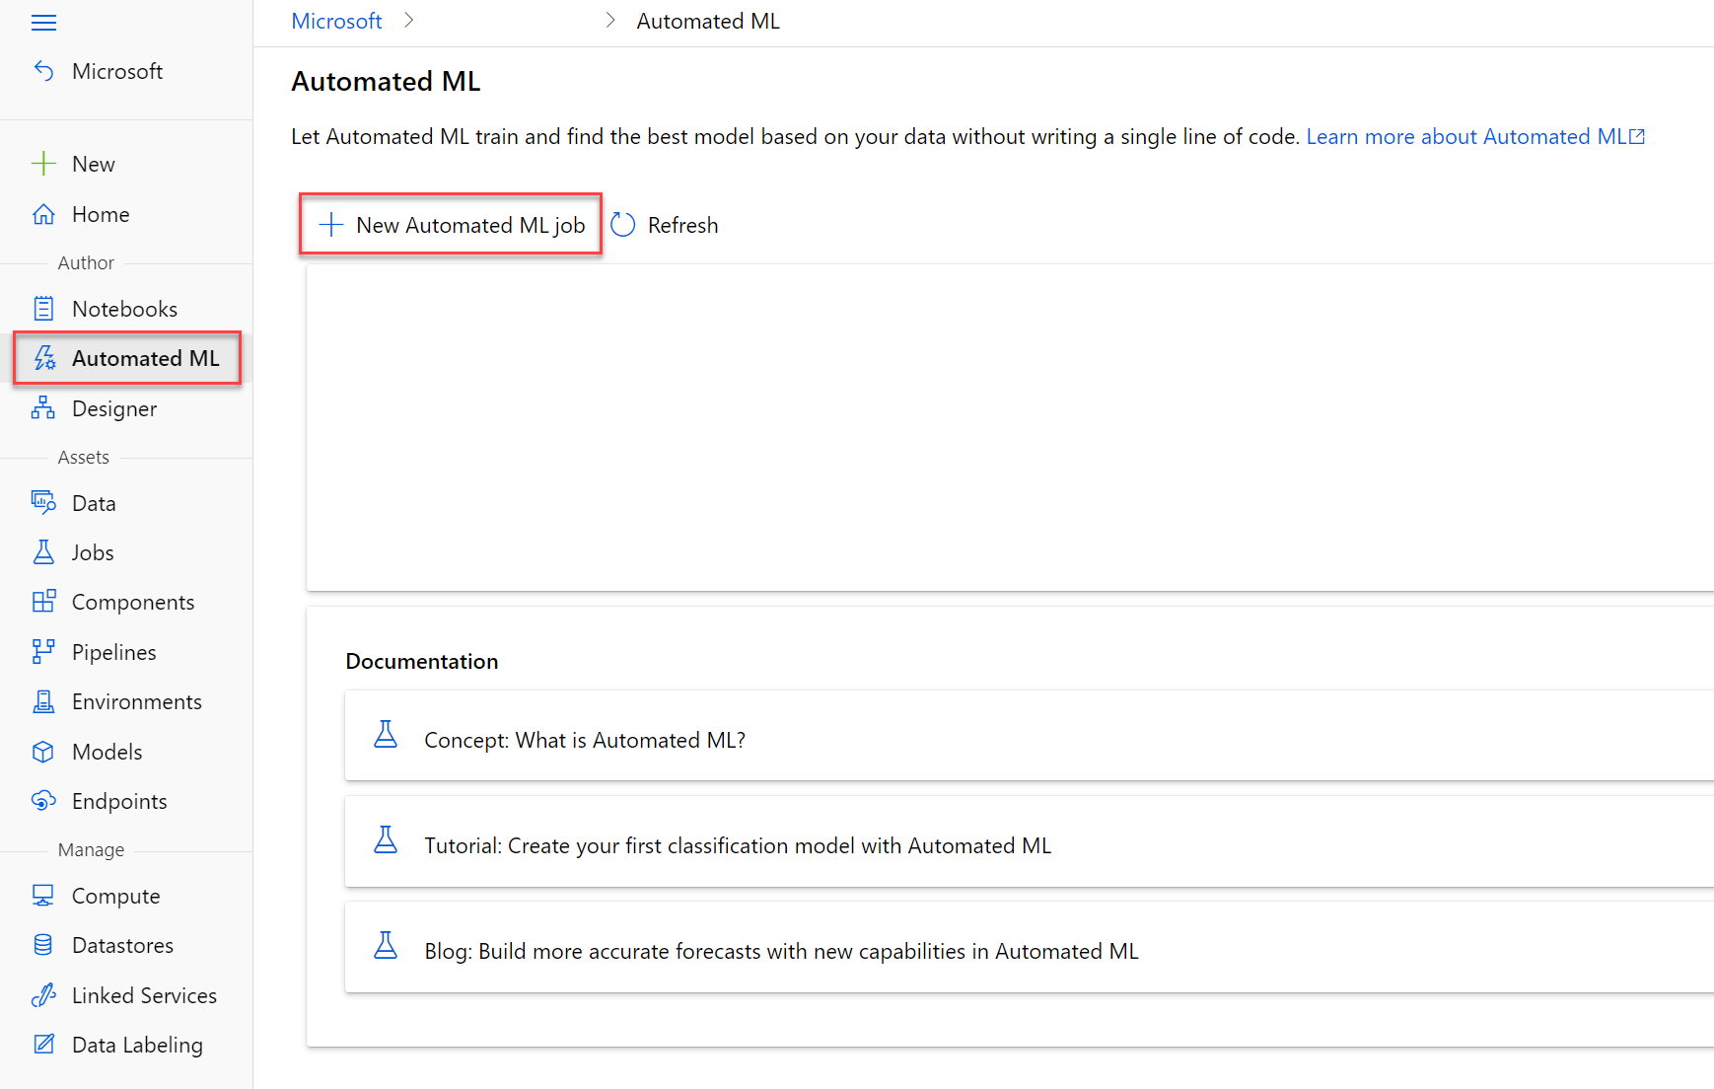
Automated Machine Learning
You can create an automated machine learning job in Azure Machine Learning studio.

Slide 5
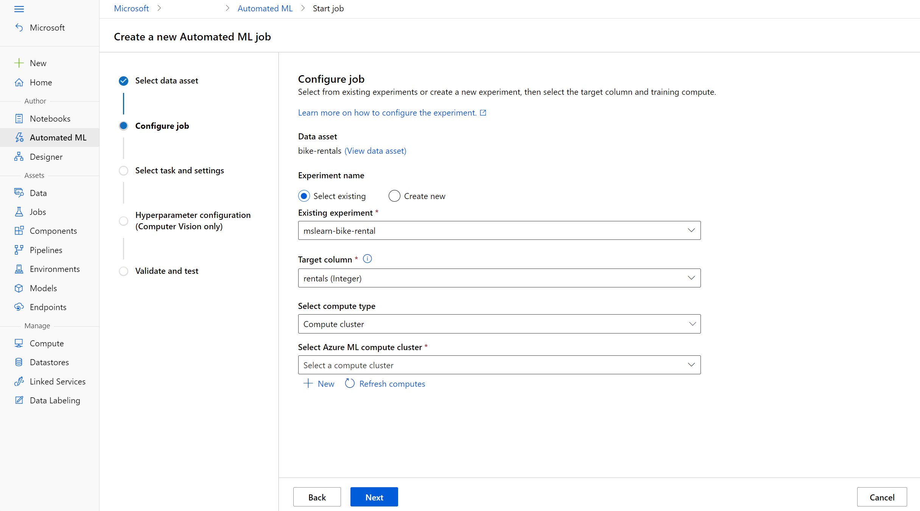
Automated Machine Learning
In Azure Machine Learning, operations that you run are called jobs. You can configure multiple settings for your job before starting an automated machine learning run. The run configuration provides the information needed to specify your training script, compute target, and Azure ML environment in your run configuration and run a training job.

Slide 6
Understand the AutoML process
You can think of the steps in a machine learning process as:
Prepare data: Identify the features and label in a dataset. Pre-process, or clean and transform, the data as needed.
Train model: Split the data into two groups, a training and a validation set. Train a machine learning model using the training data set. Test the machine learning model for performance using the validation data set.
Evaluate performance: Compare how close the model's predictions are to the known labels.
Deploy a predictive service: After you train a machine learning model, you can deploy the model as an application on a server or device so that others can use it.

Slide 7
Demo
Use Automated Machine Learning

Slide 8
References
Microsoft Docs

